Slide 1
3. Login screen
ASEAN Skills 2016
MARATHON SKILLS 2016
Coordinators and administrators can log in to the system using their email and password.
Login Form
Please log in to the system using your email address and password.
Email:
Enter your email address
Password:
Enter your password
Login
Cancel
Hotel Application

Slide 2
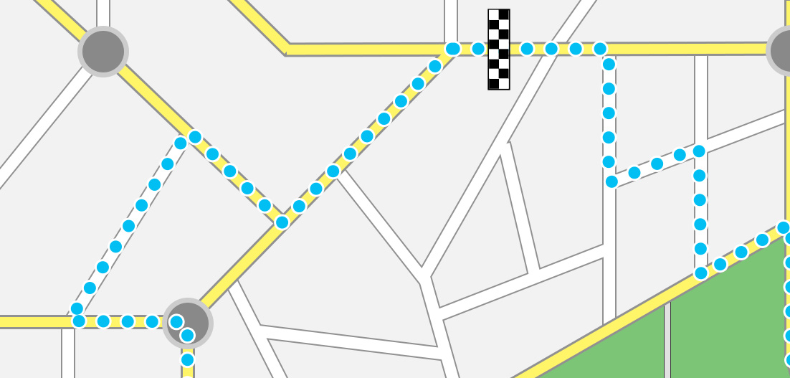
ASEAN Skills 2016
Back
Hotel Management
Logout
Add Hotel
Move Hotel
Zoom In
Zoom Out
Add Hotel
Move Hotel
Zoom In
Zoom Out
H
H
H
Hotel Name | Room Type | Price | Quantity
First | Single | 100 | 30
First | Double | 200 | 50
Second | Twin | 300 | 20
Hotel Application

Slide 3
ASEAN Skills 2016
Back
Add Hotel
Logout
Hotel Name:
High end
No. Room Single:
100
Price:
$1000
No. Room Double:
100
Price:
$1000
No. Room Twin:
100
Price:
$1000
Save
Cancel
Hotel Application

Slide 4
ASEAN Skills 2016
Back
Reservation Management
Logout
Zoom In
Zoom Out
Reserve
Zoom In
Zoom Out
H
H
H
Hotel Name | Room Type | Price | Quantity
First | Single | 100 | 30
First | Double | 200 | 50
Second | Twin | 300 | 20
Hotel Application

Slide 5

ASEAN Skills 2016
Back
Reserve Hotel
Logout
Hotel Name:
Hotel ABC
Price
Quantity
Single:
$100
15
Double:
$200
25
Twin:
$300
5
Date in:
2016-09-06
Date out:
2016-09-25
Name:
Customer name
Email:
Customer email
Reserve
Search
Hotel Application

Slide 6
ASEAN Skills 2016
Back
Search Results
Logout
Hotel Name | Single | Double | Twin
Hotel ABC | $500 | $250 | $600
Hotel XYZ | $400 | $400 | $600
Third | $400 | $300 | $400
Select
Select
Select
Hotel Application

